Slide 1
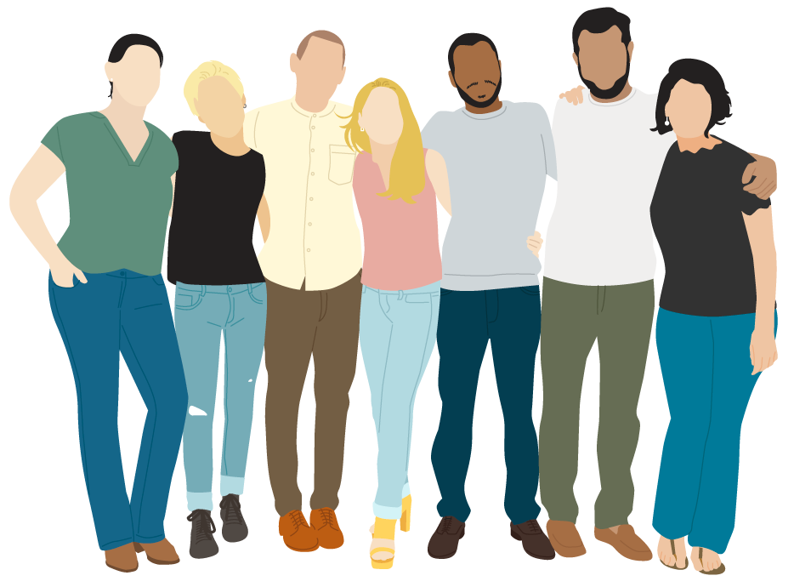
TO BUILD HEALTHY RELATIONSHIPS

Slide 2
WOULD YOU RATHER
Meet your favorite superhero
Meet your favorite celebrity

Slide 3
OBJECTIVES
Review different types of relationships
Learn how to make a choice to build a healthy relationship
Reflect on what a healthy relationship looks like

Slide 4
WHAT KIND OF RELATIONSHIPS DO WE HAVE?
A relationship is when two or more people have a connection and choose to pursue that connection.
There are all kinds of people who we can choose to have relationships with.
Examples include:
Platonic, romantic, familial, colleagues, acquaintances
Every day we choose to engage in all kinds of relationships with different people. Each relationship we have is unique!

Slide 5
HEALTHY RELATIONSHIPS
We can make a choice to have healthy relationships.
Healthy relationships can grow with:
Time
Effort
Support
Trust

Slide 6
DISCUSSION
What qualities do you look for in someone you are choosing to have a relationship with?

Slide 7
WHAT MAKES A HEALTHY RELATIONSHIP?
Notes:
https://youtu.be/UB9anEZx9LU

Slide 8
HEALTHY RELATIONSHIPS HAVE…
Communication
Conduct
Healthy Communication Includes:
Honestly expressing your feelings
Thinking before you speak
Hearing each other out
Healthy conduct can look like:
Treating each other with love and care
Appreciating each other

Slide 9
HEALTHY RELATIONSHIPS HAVE…
Commitment
Compatibility
Healthy commitment includes:
Spending time with each other
Making decisions together
Supporting each other, even through difficult situations
Healthy compatibility can look like:
Sharing interests or likes
Respecting difference
Trying things your partner likes and vice versa

Slide 10
HEALTHY RELATIONSHIPS HAVE…
Compromise
Consideration
Healthy compromise includes:
Expressing each other's points of view
Coming to an agreement together
Treating each other fairly
Healthy consideration can look like:
Treating each other with respect
Trying to understand each other's perspectives
Giving each other time and space to process

Slide 11
Which of the 6 Cs do you think is the most important?
DISCUSSION

Slide 12
THINK ABOUT IT…
What is the most important relationship in your life?
What makes it special?
What are some healthy qualities about this relationship?

Slide 13
WE SHIP TEAM!
Notes:
https://youtu.be/_IQOr7otBQU

Slide 14
MAKE A CHOICE!
You can make a choice to have healthy relationships.
What is one choice you will make to build healthier relationships?

Slide 15
CHECK OUT
What will you do for yourself today?
Turn On Your
Favorite Playlist
Create a
Gratitude List
Take Some
Deep Breaths
Drink More
Water

Slide 16
Committed to fostering a safe and respectful District, school and community culture where the seeds of peace and justice are sown so that all students and staff can lead safe, purposeful and academically fruitful lives.
Connect with us at bit.ly/LAUSD-HRDE

